Slide 1
SUMMER TRAINING COURSE-CSE443
Name: SHAIK JULFEEN AHMADH
Reg. No: 12110554
Section:K21UG

Slide 2
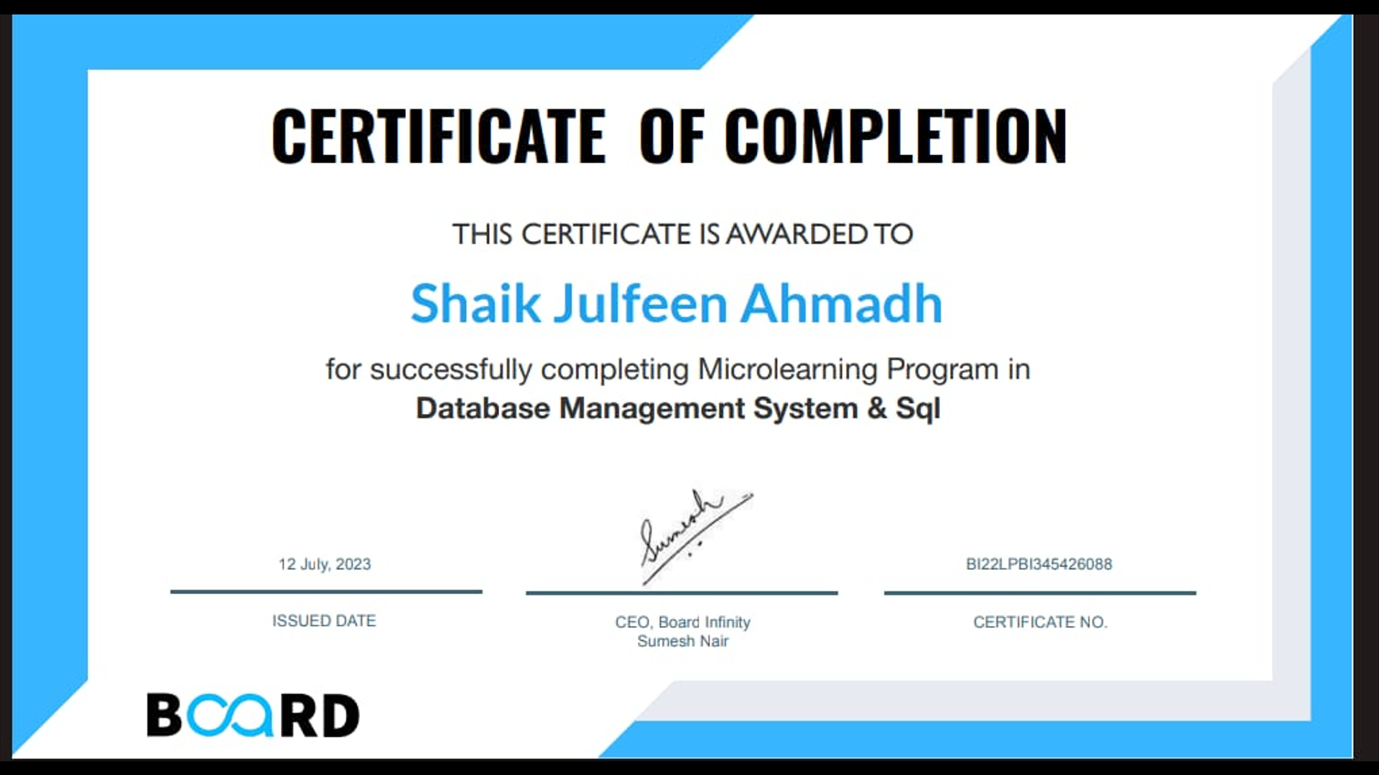
Certificate

Slide 3
Topics Covered:
What is Database Management System
Types of Database Management System
What is SQL
SQL Classification
SQL Data Types
Table Constraints
SQL Statements
Order of Execution
SQL Functions
Normal Forms
Data Security

Slide 4
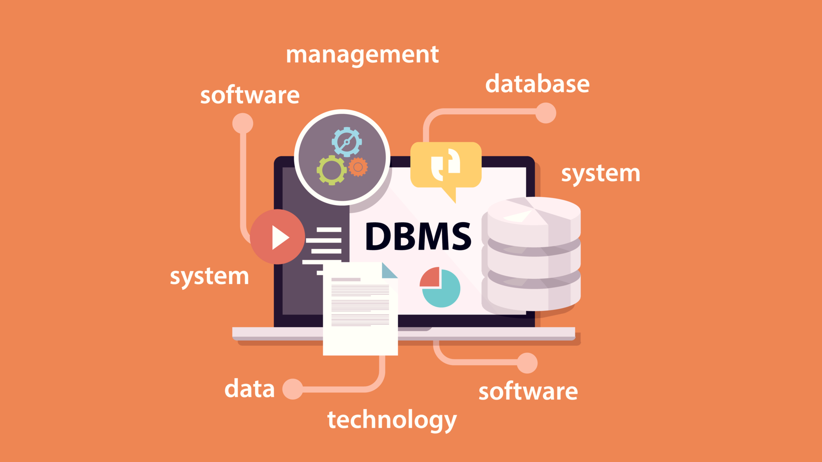
What is a Database Management System?
A Database Management System (DBMS) is a software system that allows users to define, create, maintain and control access to a database.
It provides an interface for interacting with the database and manages the storage, retrieval, and modification of data. In simple terms, a DBMS is like a librarian who organizes and maintains a library's collection of books.
The role of a DBMS in managing data is crucial as it ensures data integrity, security, and availability.

Slide 5
Types of Database Management Systems
There are three main types of database management systems: relational, hierarchical, and network.
Relational databases
- Examples include MySQL, Oracle, and Microsoft SQL Server.
Hierarchical databases
- Examples include IBM's Information Management System (IMS) and Windows Registry.
Network databases
- Examples include Integrated Data Store (IDS) and IDMS.
The choice of DBMS depends on the specific needs of an organization. Relational databases are best suited for applications that require complex queries and reporting, while hierarchical databases are ideal for storing large amounts of data with simple relationships. Network databases are best suited for applications with complex relationships between data elements.

Slide 6
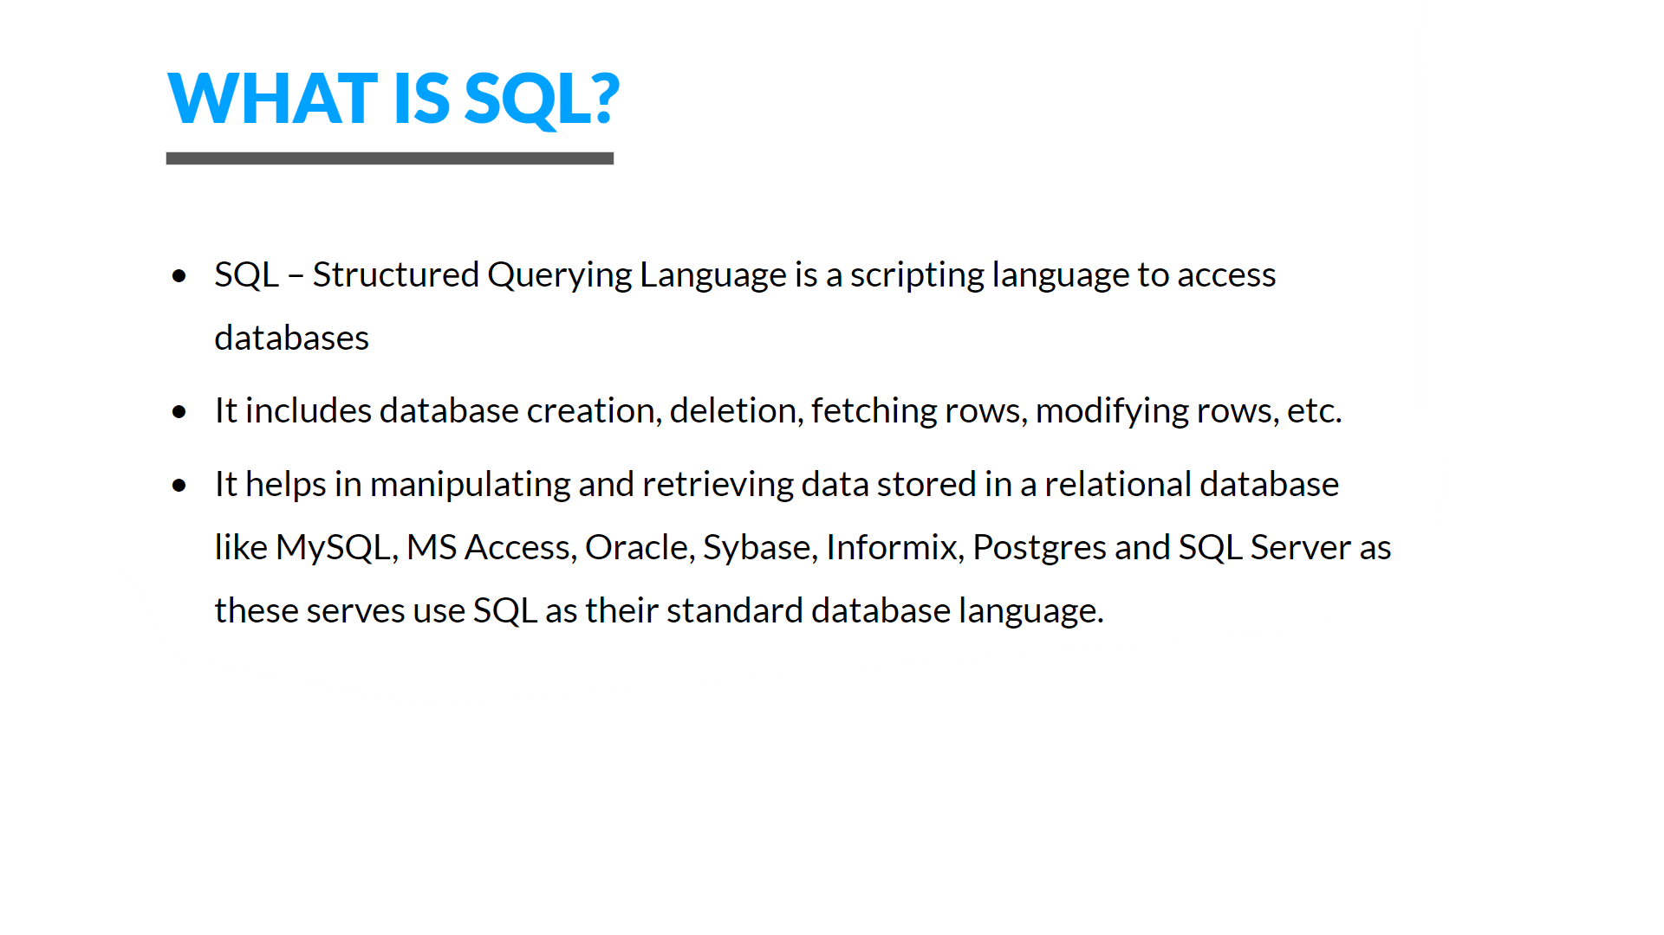

Slide 7
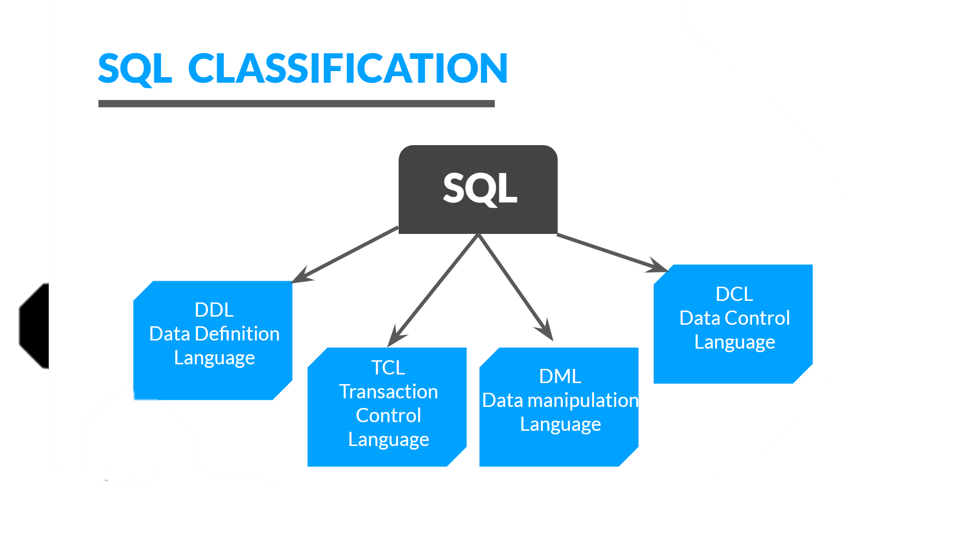

Slide 8
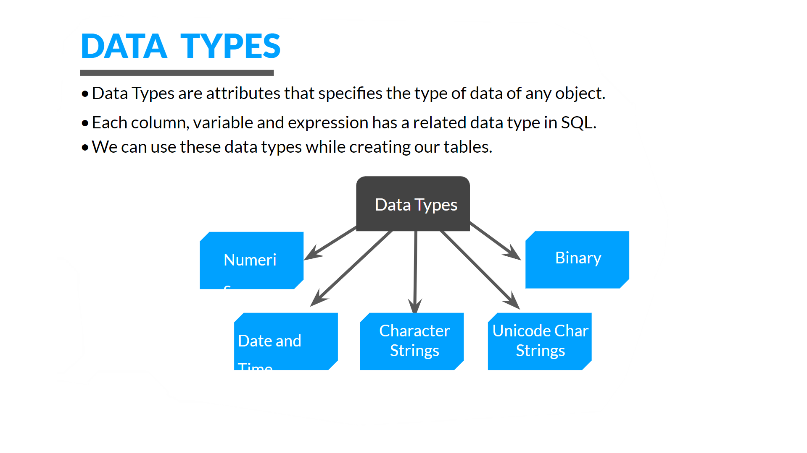

Slide 9
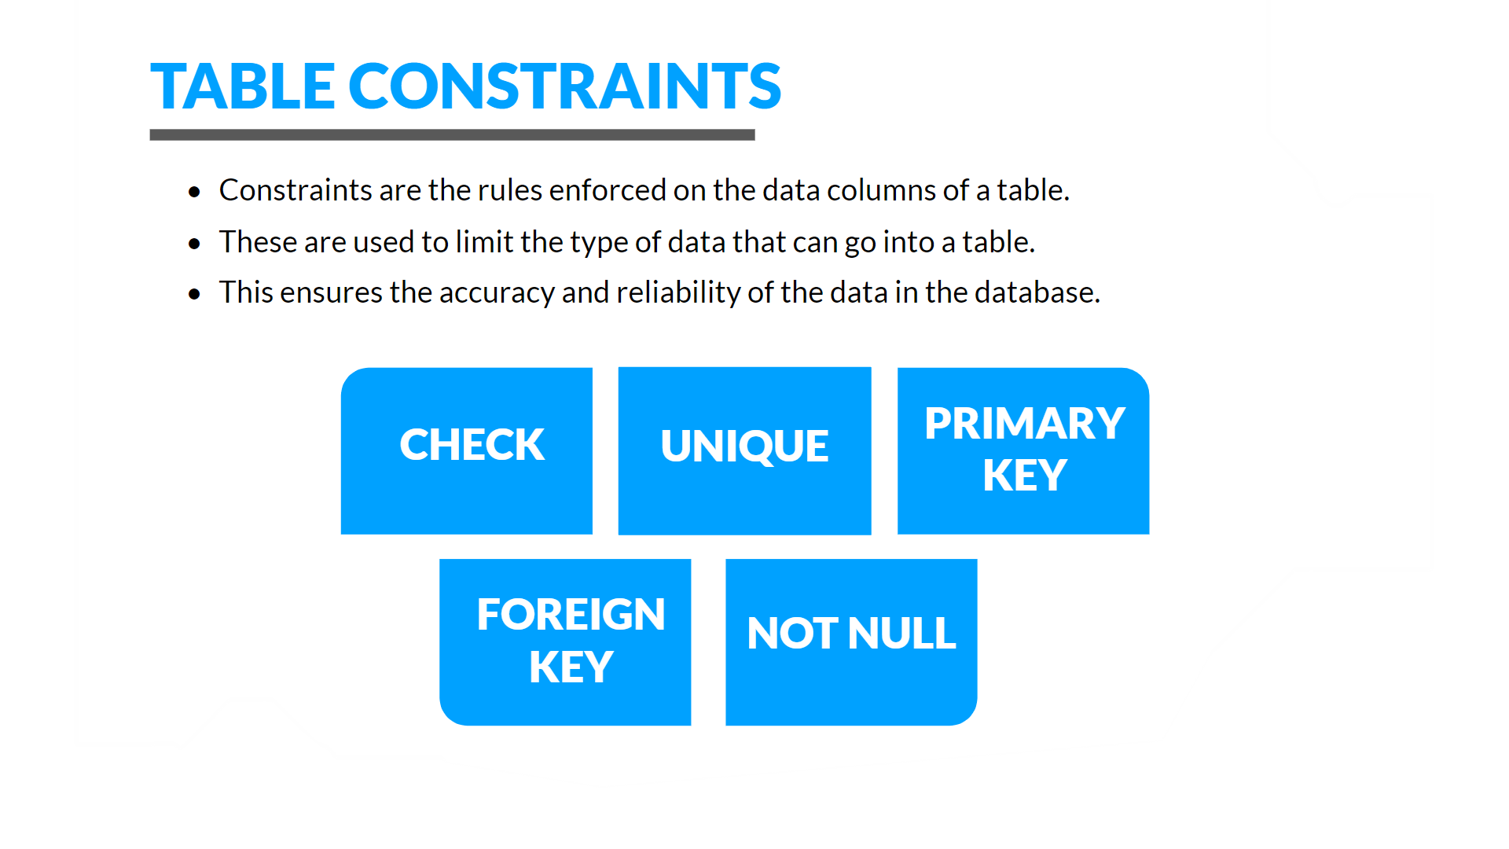

Slide 10
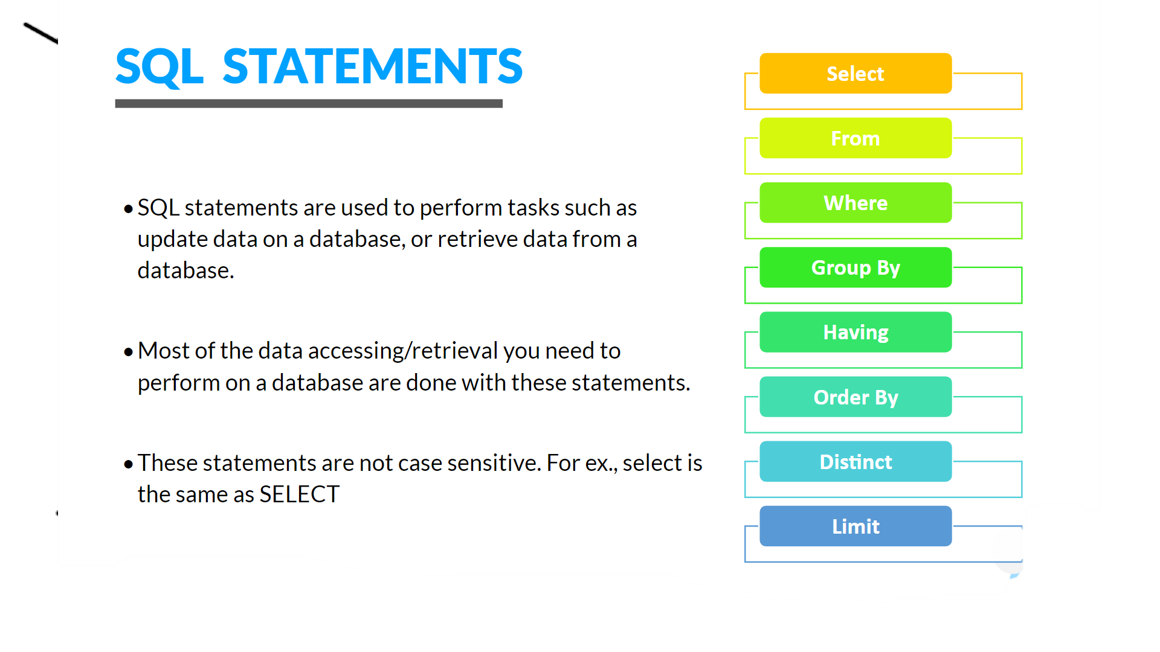

Slide 11
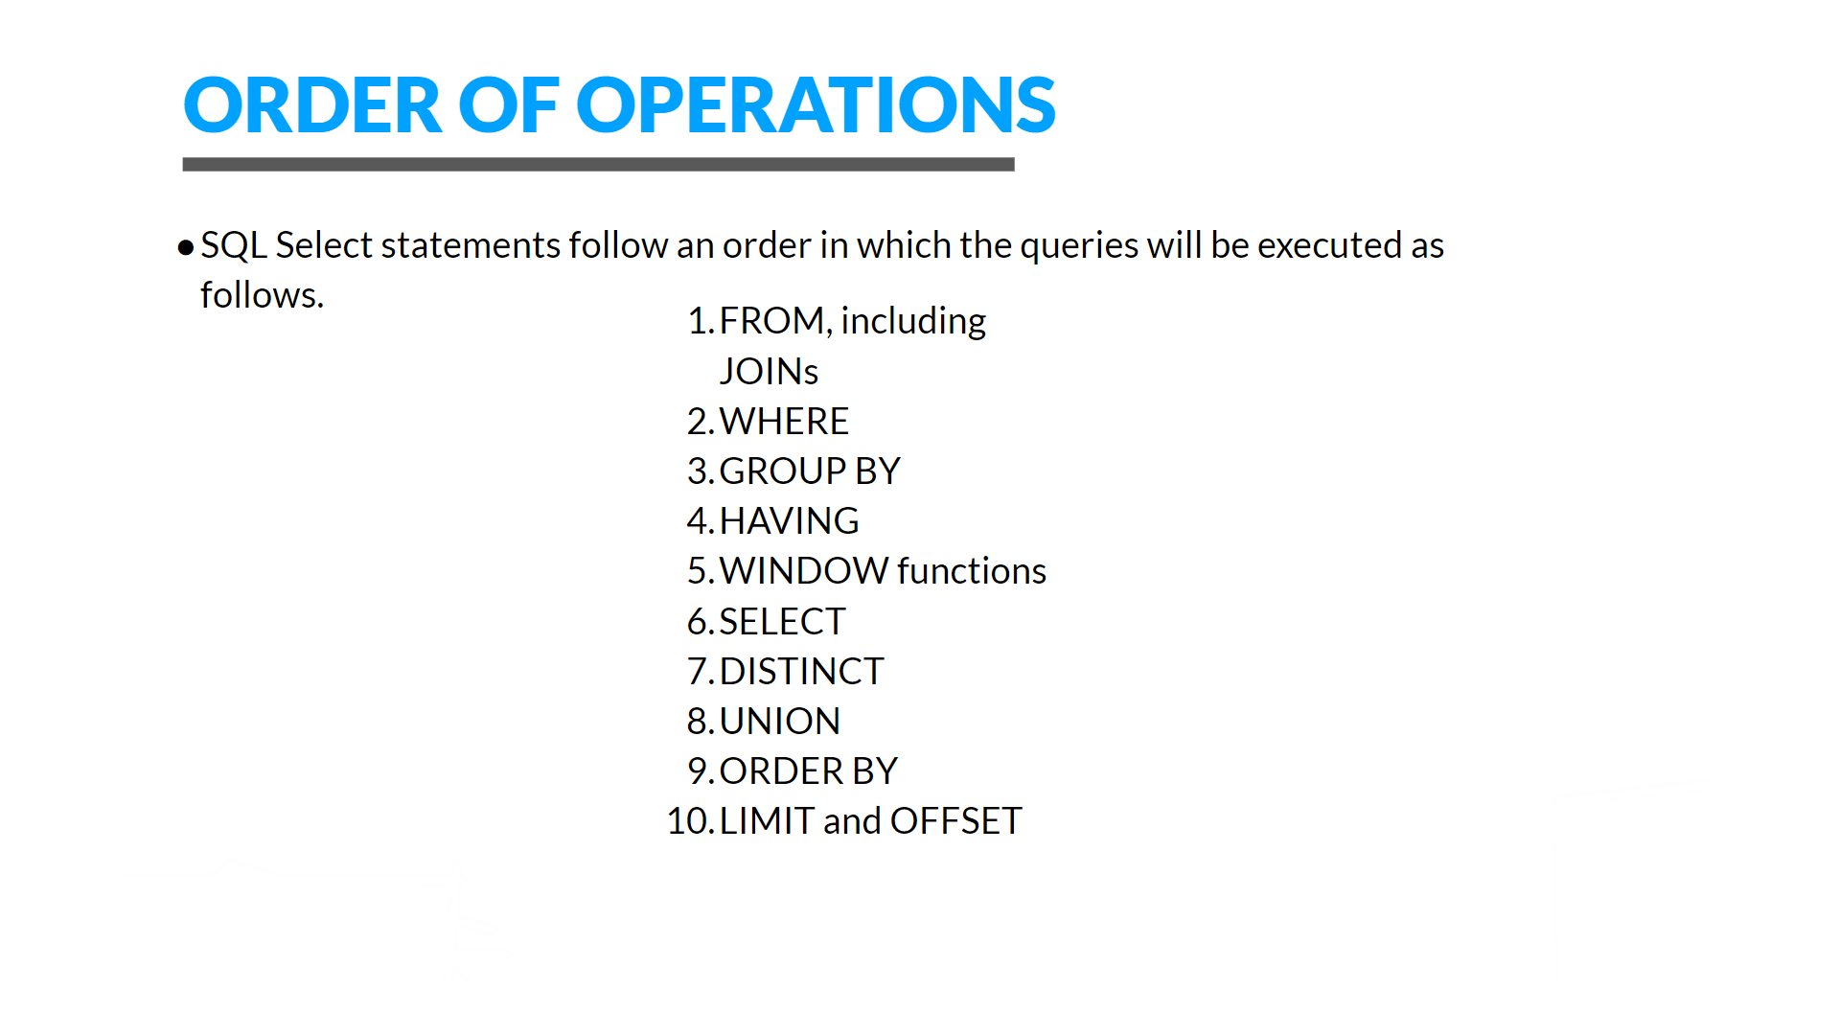

Slide 12
SQL FUNCTIONS:
Logical functions
AND, OR, NOT, IN, NOTIN, BETWEEN , LIKE, NOTLIKE …..
Arithmetic Functions
SUM , AVERAGE , COUNT , MINIMUM , MAXIMUM …..
Date Functions
DAY, DATE, CURRENTDATE , CURRENTTIME, HOUR ……
String Functions
CONCAT , LOWER , UPPER , SUBSTRING, LEFT , RIGHT ……
Window Functions
RANK , DENSERANK, LEAD, LAG , ROWNUMBER

Slide 13
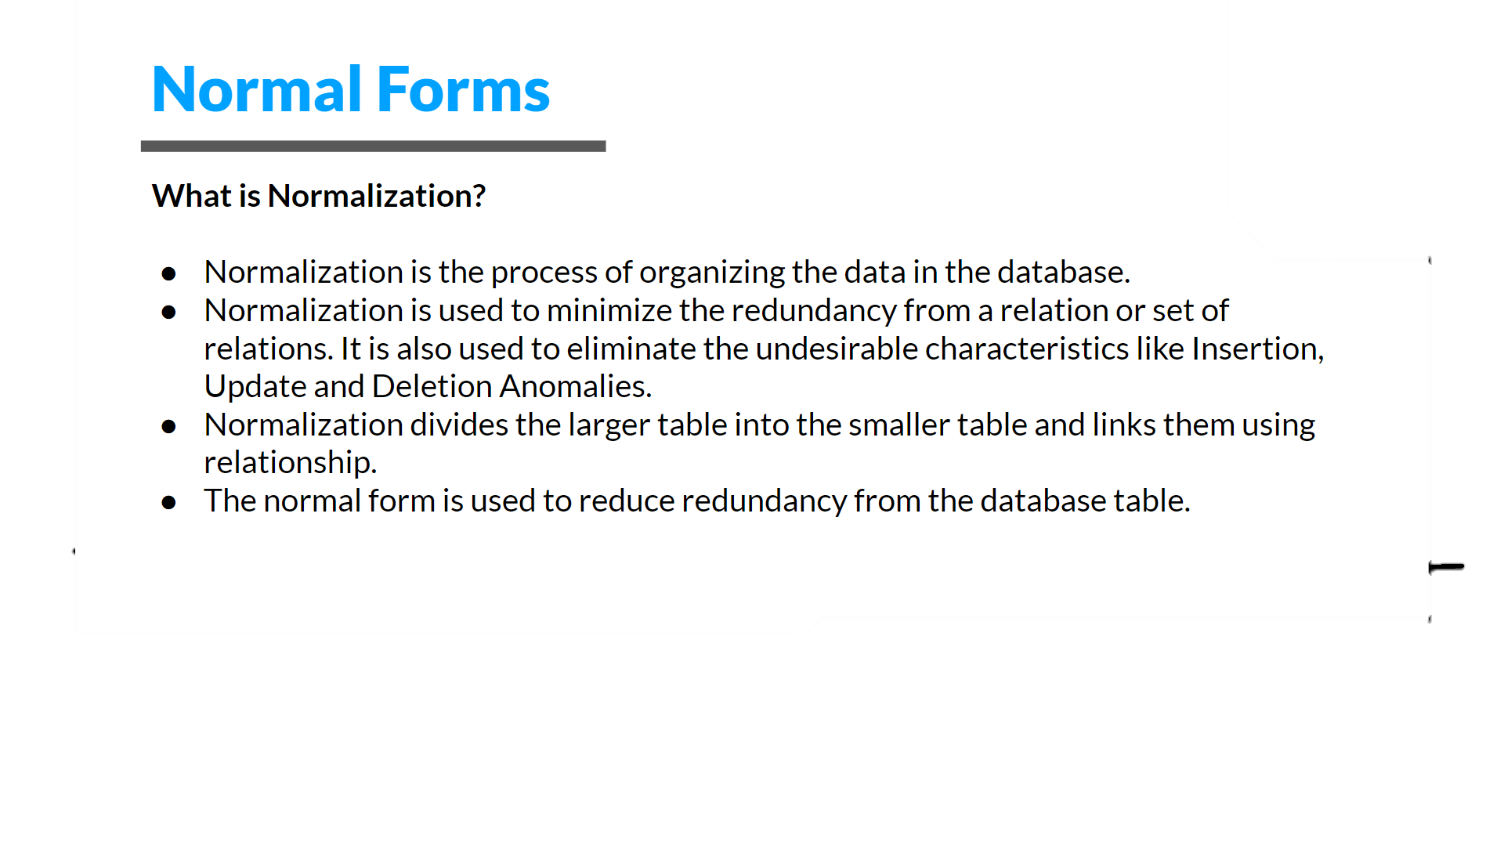

Slide 14
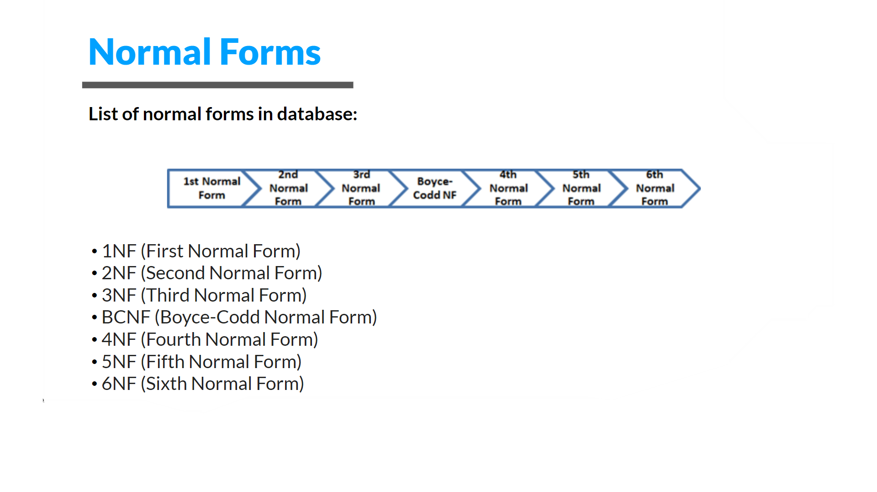

Slide 15

Database Security
Database security is a critical aspect of managing data, as it ensures that sensitive information remains protected from unauthorized access and manipulation. There are several techniques used to secure a database, including encryption, access control, and auditing.
Encryption involves converting data into a code that can only be deciphered with a specific key or password.
Access control involves setting permissions for different users or groups, so they can only access the data they need.
Auditing involves monitoring the database for any suspicious activity and keeping a record of all actions taken.

